Slide 1
Opening of New Multiplex in Hyderabad, India
IBM Data Science Capstone
By
Vinay K

Slide 2
Business problem:
Day by day so many Multiplexes were getting built in major cities like Hyderabad.
But most of the Multiplexes are built in the same place which will result in less profits.
So by using data science to find the perfect place to build a new Multiplex will increase their profits.
But due to the unavailability of Multiplexes near to there area and also the traffic in the city makes it difficult to watch movies in Multiplexes.
Particularly the location of Multiplexes is one of the most important factors which decides the success of the Multiplexes.

Slide 3
Data:
To solve this data we want three types of data:
List of popular suburbs in Hyderabad. We can get this data fro wikipedia page “https://commons.wikimedia.org/wiki/Category:Suburbs_of_Hyderabad,_India”
Latitude and longitude coordinates of these suburbs. We can get this data from python geocoder package.
Venue data to find the shopping malls. We can get this data from Foursquare API

Slide 4
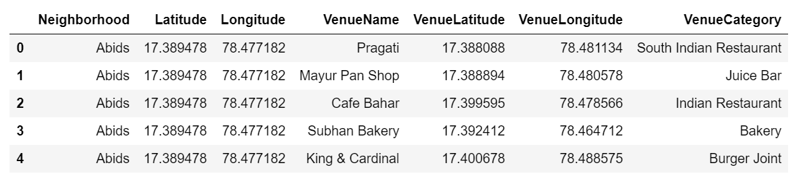
Collecting Venues using Foursquare api:
I utilized the Foursquare API to explore the boroughs and segment them.
I designed the limit as 100 venue and the radius 10000 meter for each borough from their given latitude and longitude informations.
Here is a head of the list Venues name, category, latitude and longitude informations from Foursquare API.

Slide 5
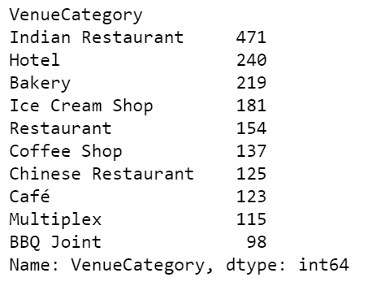
Most famous places in Hyderabad
We can see that Multiplex is also one most famous places in hyderabad.
So we can use these Multiplex data to cluster them.
Using those cluster data we can find the best place to build a new Multiplex

Slide 6
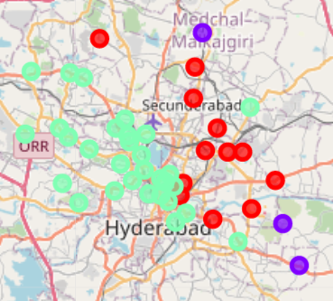
Clustering Multiplex data

Slide 7
Conclusions
As we can see more Multiplexes are concentrated in green clusters compared to remaining clusters.
So there is more chance of getting profits when we build in remaining clusters as there is less competition in those areas.

